Slide 1

ICT406 IT Professional Environment: Law, Ethics and Privacy Machine Ethics
Dr. Abbass Ghanbary
a.ghanbary@aapoly.edu.au

Slide 2
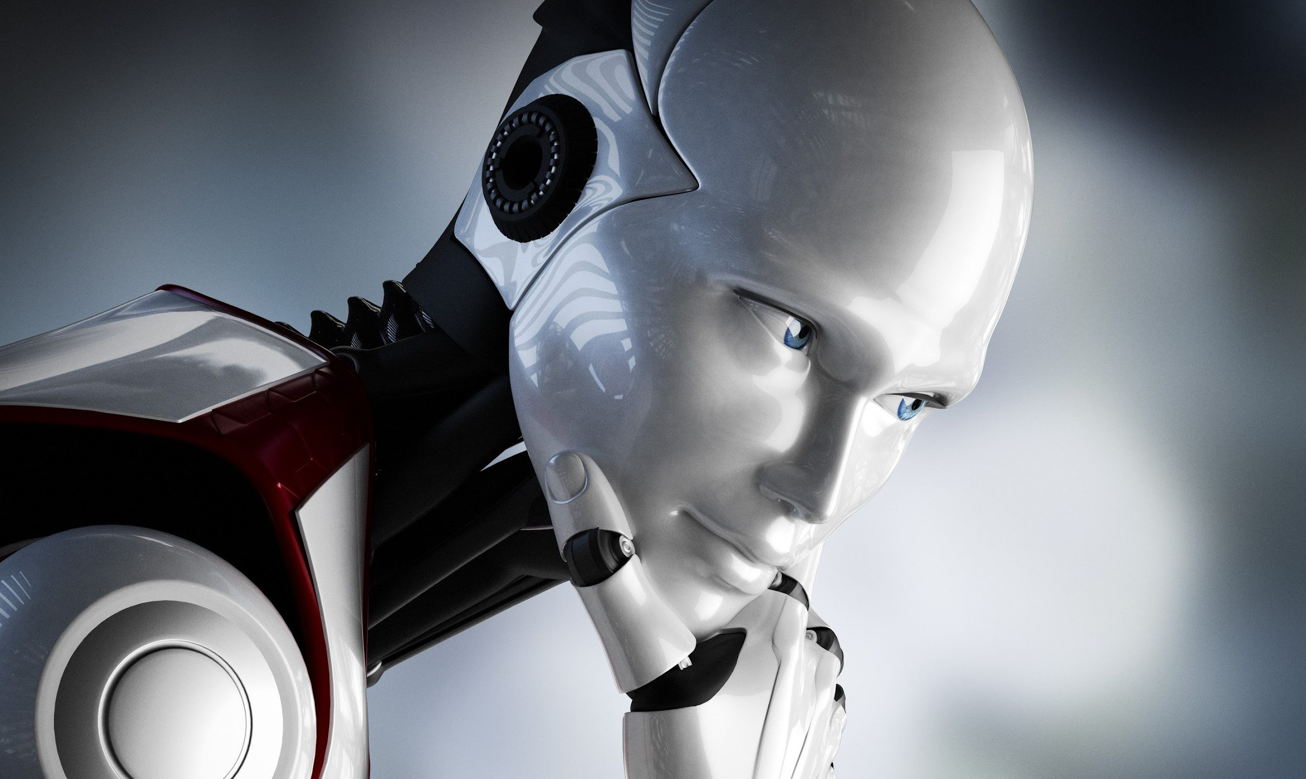

Slide 3
Lecture Outline
Mind in general
Machine logic
Thinking Machine & AI
Machine Ethics

Slide 4
Mind in General
What does the mind represent? Our thought?
Is it philosophical?
Is it related with senses?
Is it measurable?
Is it only for humans?
Is it linguistic, pictorial or a symbolic representation of:
Our memory
Our will
Our personality
Our emotions and feelings
Our imagination
Notes:
Many new database developers suffer from the ‘spreadsheet syndrome’, creating as few tables as possible, often just a single table. They place dozens of columns in their table, to try and cover every possible piece of data, even though they often leave most columns unfilled for a given row.
By contrast database normalization aims to store the smallest amount of info possible in each table, leaving no columns that are filled for just a few of the rows. In fact, in a properly normalized table there should be very few empty(NULL) fields.
This is accomplished by restructuring the data into multiple tables, with each table containing a subset of the information.
Database normalization is the process of modifying your schema so that its tables conform to a progressive series of normal forms.

Slide 5
Mind in General (Cont)
Does the computer follow human mind because we designed them?
Or, our mind is a calculative computer. Because we are all familiar with the concept of arithmetic in our daily lives.
Notes:
Many new database developers suffer from the ‘spreadsheet syndrome’, creating as few tables as possible, often just a single table. They place dozens of columns in their table, to try and cover every possible piece of data, even though they often leave most columns unfilled for a given row.
By contrast database normalization aims to store the smallest amount of info possible in each table, leaving no columns that are filled for just a few of the rows. In fact, in a properly normalized table there should be very few empty(NULL) fields.
This is accomplished by restructuring the data into multiple tables, with each table containing a subset of the information.
Database normalization is the process of modifying your schema so that its tables conform to a progressive series of normal forms.

Slide 6
Computational Logic
Compute means “calculate by mathematical means”
Oxford Dictionary
Computer languages provides the set of syntax and instructions for computers that can basically be classified in three categories:
Sequential
Selection
Iteration
We are using the same instruction to program a machine mind basically to follow the given instructions.
Notes:
And hey, odds are you can change more than one column, and you may have more than a million rows.

Slide 7
Thinking Computers
Can a computer think? According to (Turing, 1950) if a person cannot tell the difference between the conversation with the other person and the conversation with the machine, then we can say that the machine is thinking.
The most common cause of robot mistakes is programming errors. If a robot’s programming is incorrect, it can lead to incorrect execution of tasks. It’s not really the robot’s fault.
https://www.indramat-us.com/do-robots-make-mistakes/
The future cooperation with robots requires an intensive investigation of interaction concepts and learning approaches in robot systems with regard to their applicability in poorly controlled environments.
Kim, S.U. (et, al). (2020). Errors in Human-Robot Intercations and their Effects on Robot Learning.
https://www.frontiersin.org/articles/10.3389/frobt.2020.558531/full

Slide 8
Artificial Intelligence
Is AI a thinking machine? As an example: ChatGPT is not a thinking machine but following set of rules to access the existing information in various resources and present them back to you.
Argument: Thinking machine is different with human
thinking because follows different logical expressions.
A robot that is designed to do a specific task even better than humans are called expert system. Is expert system an AI because this system is thinking to do a better job than humans.

Slide 9
Computers and Humans
Computers:
Faster calculations
Efficient storage
Rapid retrieval of required information
Following given instructions
Humans:
Emotions and sympathy
Imagination and creativity
Control and will powers
Unique characteristic and personality
Therefore, we can’t compare a machine to human. Can we create an Artificial Intelligence? or intelligence is biological?

Slide 10
Machine Ethics
This is purely related to how human interacts with machines.
Machine ethics must have different meaning because it can’t be related to moral values but set of rules and regulations.
Can ethics will be embedded in machine? But different people have different ethical values. How would we manage it?
Is Asimov Law sufficient? But this has not been officially accepted yet.

Slide 11
Main Position on Roboethics
According to the anthropologist Daniela Cerqui, three main ethical positions emerged from the robotics community:
1: Not interested in ethics: This is the attitude of those who consider that their actions are strictly technical, and do not think they have a social or a moral responsibility in their work.
2: Interested in short-term ethics: This is the attitude of those who express their ethical concern in terms of “good” or “bad,” and who refer to some cultural values and social conventions. This attitude includes respecting and helping humans in diverse areas, such as implementing laws or in helping elderly people.
3: Interested in long-term ethics: This is the attitude of those who express their ethical concern in terms of global, long-term questions: for instance, the “Digital divide” between South and North; or young and elderly. They are aware of the gap between industrialized and poor countries, and wonder whether the former should not change their way of developing robotics in order to be more useful to the latter.
Cerqui, D. (2002). The future of humankind in the era of human and computer hybridization: An Anthropological analysis. Springer Link. https://link.springer.com/article/10.1023/A:1019940127052

Slide 12
Common Roboethics Issues
Similar issues with ICT:
A technology is always accessible to people with different intentions.
Humans praising the machine
Alienation and isolation of humans (and, machine addiction)
Human usage of technology by skills, age. Geographical regions and…
Technological effects on political, social, cultural, environment ….. Factors
Artificial mind and artificial body

Slide 13
Common Roboethics Issues (cont)
Robots could be unpredictable.
Robots follow their instruction that at time might not be compatible to human logic. eg: in an accident, a robot might save an old person with higher chance of survival, but a human would save their child first.
Featural characteristic of robots might be the same. Who done it?

Slide 14
Final Thought
Based on this discussion, we can conclude that currently, humanity is in no position to make the final decision. We must be prepared by protecting our privacy, safety and security.
Register all robots’ behaviour in an audit log.
Make them identifiable

Slide 15
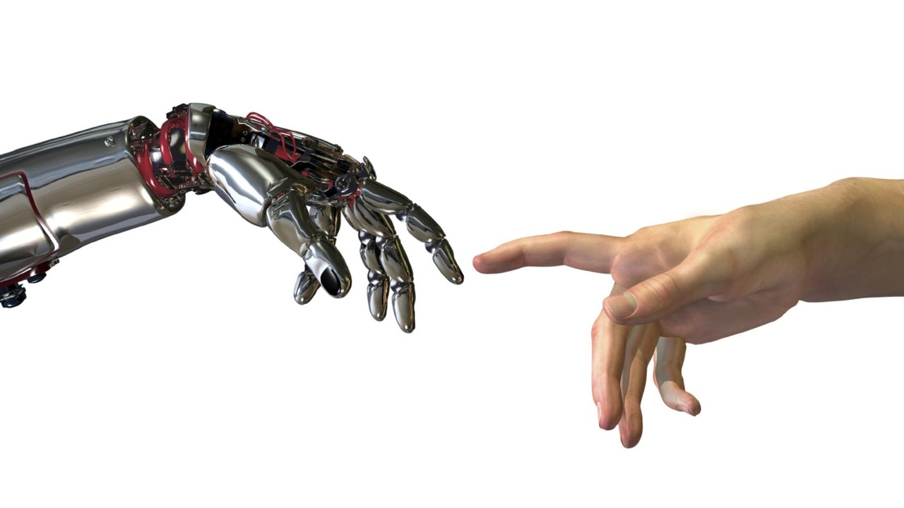

Slide 16
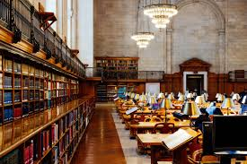
Reading Materials

Slide 17
Articles and Books
Bertrand Russell, The Analysis of Mind (London: George Allen and Unwin 1921), Chapter 12.2 Quoted in H. Feigl, The “Mental” and the “Physical” (Minneapolis, Minn.: University of Minnesota Press 1967), p. 138.
Turing, A.M. (1950). Computing machinery and intelligence. Volume LIX, Issue 236, October 1950, Pages 433–460, https://doi.org/10.1093/mind/LIX.236.433
Roger Penrose, The Emperor’s New Mind (London: Vintage 1990), p. 526.
Franz Brentano, Psychology from an Empirical Standpoint (originally published 1874; English translation by Rancurello, Terrell and McAlister; London: Routledge and Kegan Paul 1973), p. 88.
John R. Searle, Intentionality (Cambridge: Cambridge University Press 1983).
Lewis Wolpert, Malignant Sadness: The Anatomy of Depression (London: Faber 1999).

